Slide 1
8- Formatting Python Code

Slide 2
Context
Python Enhancement Proposals (PEPs) 3
Ex.1 9
Command palette
Format Document | Execute 11
Install “Formatter autopep8“ 12
Format Document | Execute again 13
Ex.2 14
Format On Save 15

Slide 3
Python Enhancement Proposals (PEPs)
In Python Community, We have a bunch of documents called python enhancement proposals or peps

Slide 4
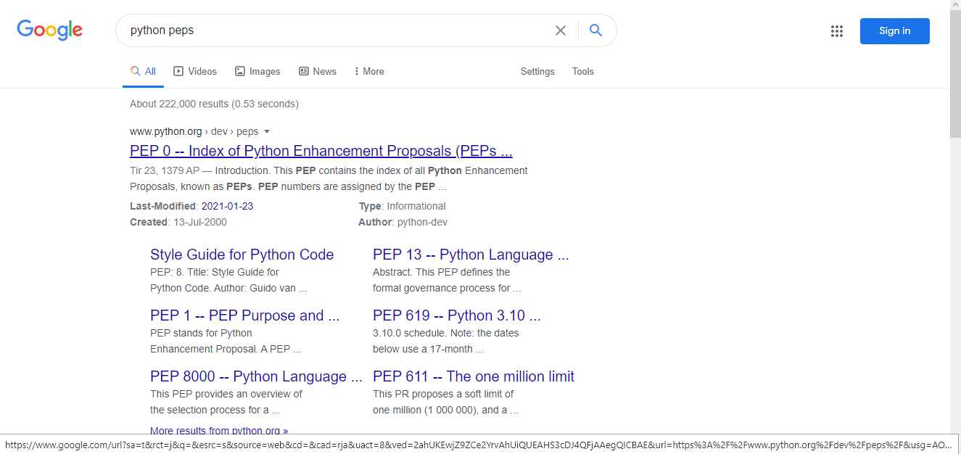
In google search “python peps”
you can see the list of all this paps under www.python.org › dev › peps

Slide 5
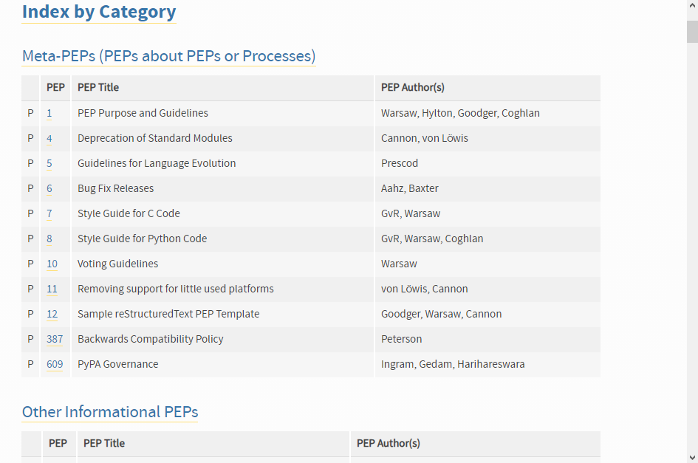
each pep has a number and a title

Slide 6
The one that is very popular amongst python developers is pep 8
which is a style guide for python code.
a style guide is basically a document that defines a bunch of rules for formatting and styling our code.
If you follow these conventions the code that you write will end up being consistent with other people's code.

Slide 7
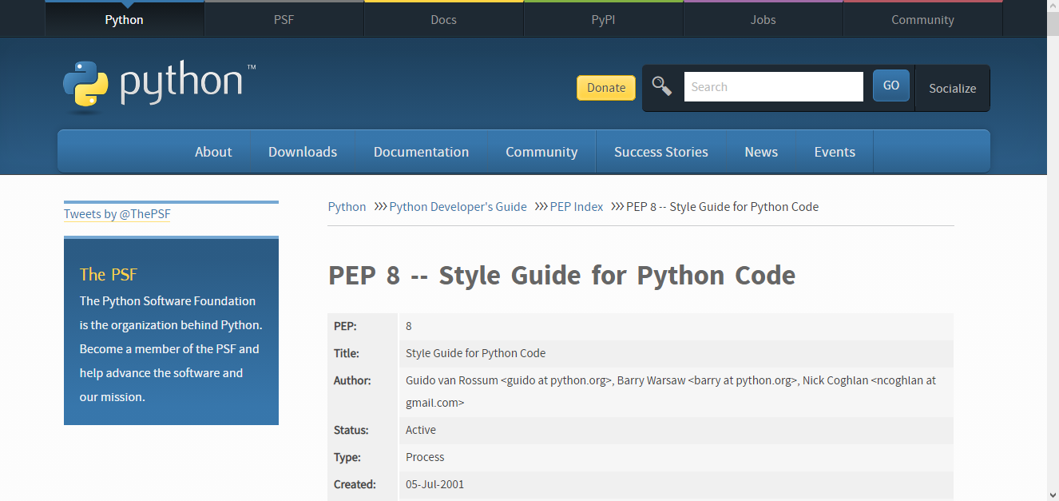

Slide 8
in this lecture, I'm gonna show you a tool that helps you automatically format your code according to pep8.

Slide 9
I'm declaring a variable and setting it to one.
according to pep8 this code is considered ugly.
Because by convention we should add a space around this equal sign or the assignment operator.

Slide 10
Now since you're starting out with python, you probably don’t know these rules.
So let me show you a tool that helps you automatically format your code.
Let's revert this back to its original state.

Slide 11

Format Document | Execute
Go to command palette
Search for format
you can see this command Format Document. Click on it.

Slide 12

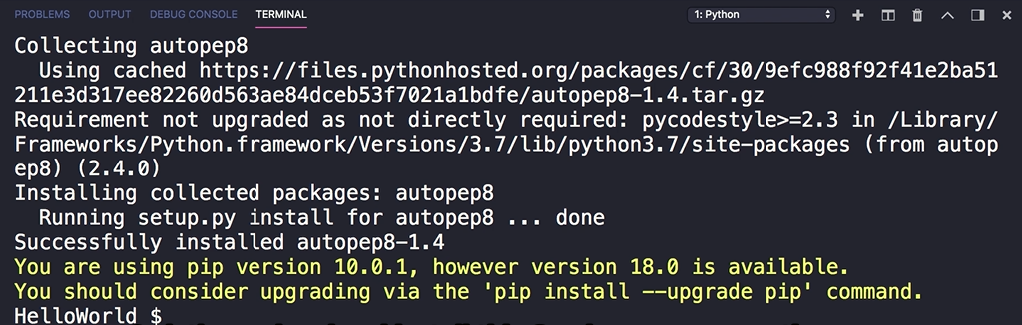
Install “Formatter autopep8”
The first time you execute this command you’re going to see this message here.
So there are a bunch of tools for formatting python code. The most popular one is autopep8 and this is the tool that this python extension We installed uses to format our code.
Click on yes

Slide 13
Format Document | Execute again
Open command palette and
execute format document again.
this tool automatically formats out code

Slide 14


EX.2
According to pep8 this is considered ugly:
let's format our code:

Slide 15
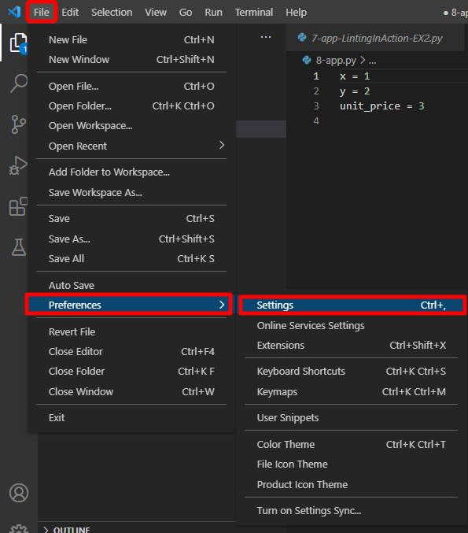
Format On Save
how to have your file automatically formatted as soon as you save the changes.
File>Preferences>Settings

Slide 16
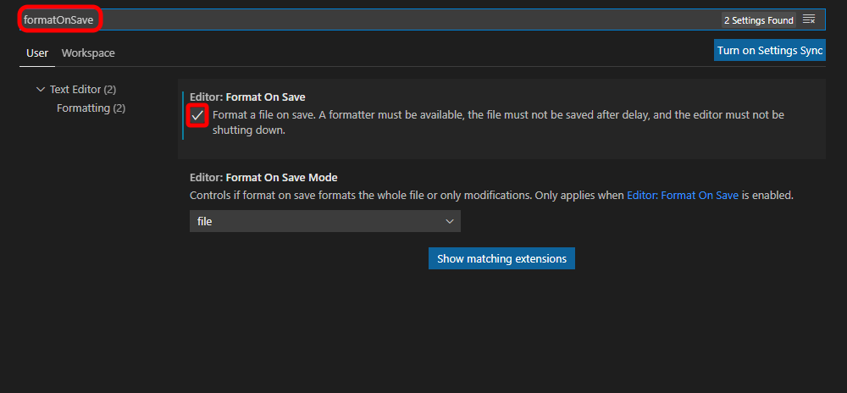
Format On Save (cont.)
search for formatOnSave.
Check “Editor Format On Save” option
Now, as soon as I save the changes you can see my code is reformatted

